Slide 1
Hash File Organization

Slide 2
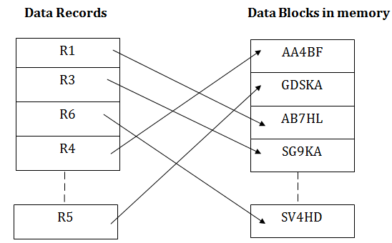
Hash File Organization uses the computation of hash function on some fields of the records. The hash function's output determines the location of disk block where the records are to be placed.

Slide 3
When a record has to be received using the hash key columns, then the address is generated, and the whole record is retrieved using that address.
In the same way, when a new record has to be inserted, then the address is generated using the hash key and record is directly inserted.
The same process is applied in the case of delete and update.
In this method, there is no effort for searching and sorting the entire file. In this method, each record will be stored randomly in the memory.

Slide 4
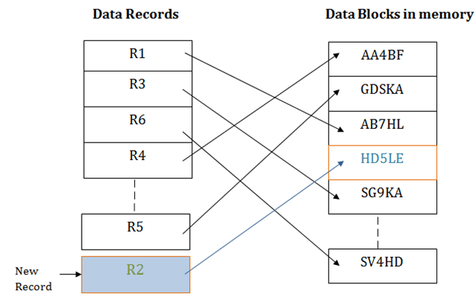

Slide 5
B+ File Organization
B+ tree file organization is the advanced method of an indexed sequential access method. It uses a tree-like structure to store records in File.
It uses the same concept of key-index where the primary key is used to sort the records. For each primary key, the value of the index is generated and mapped with the record.
The B+ tree is similar to a binary search tree (BST), but it can have more than two children. In this method, all the records are stored only at the leaf node. Intermediate nodes act as a pointer to the leaf nodes. They do not contain any records.

Slide 6
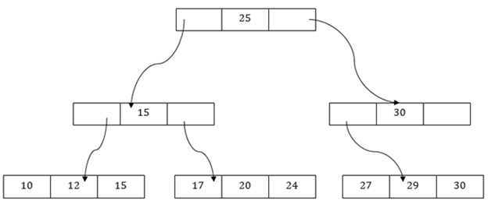

Slide 7
The above B+ tree shows that:
There is one root node of the tree, i.e., 25.
There is an intermediary layer with nodes. They do not store the actual record. They have only pointers to the leaf node.
The nodes to the left of the root node contain the prior value of the root and nodes to the right contain next value of the root, i.e., 15 and 30 respectively.
There is only one leaf node which has only values, i.e., 10, 12, 17, 20, 24, 27 and 29.
Searching for any record is easier as all the leaf nodes are balanced.
In this method, searching any record can be traversed through the single path and accessed easily.

Slide 8
Pros of B+ tree file organization
In this method, searching becomes very easy as all the records are stored only in the leaf nodes and sorted the sequential linked list.
Traversing through the tree structure is easier and faster.
The size of the B+ tree has no restrictions, so the number of records can increase or decrease and the B+ tree structure can also grow or shrink.
It is a balanced tree structure, and any insert/update/delete does not affect the performance of tree.
Cons of B+ tree file organization
This method is inefficient for the static method.

Slide 9
Indexed sequential access method (ISAM)
ISAM method is an advanced sequential file organization. In this method, records are stored in the file using the primary key.
An index value is generated for each primary key and mapped with the record. This index contains the address of the record in the file.

Slide 10
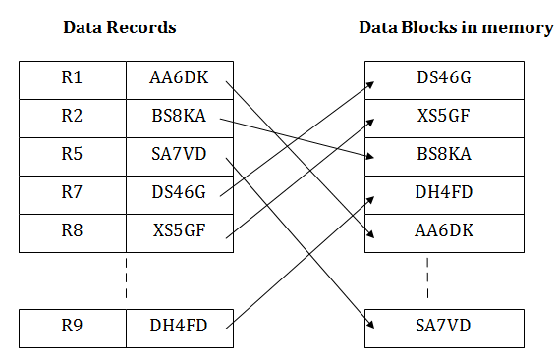
If any record has to be retrieved based on its index value, then the address of the data block is fetched and the record is retrieved from the memory.

Slide 11
Pros of ISAM:
In this method, each record has the address of its data block, searching a record in a huge database is quick and easy.
This method supports range retrieval and partial retrieval of records. Since the index is based on the primary key values, we can retrieve the data for the given range of value. In the same way, the partial value can also be easily searched, i.e., the student name starting with 'JA' can be easily searched.
Cons of ISAM:
This method requires extra space in the disk to store the index value.
When the new records are inserted, then these files have to be reconstructed to maintain the sequence.
When the record is deleted, then the space used by it needs to be released. Otherwise, the performance of the database will slow down.

Slide 12
Cluster file organization
When the two or more records are stored in the same file, it is known as clusters.
These files will have two or more tables in the same data block, and key attributes which are used to map these tables together are stored only once.
This method reduces the cost of searching for various records in different files.
The cluster file organization is used when there is a frequent need for joining the tables with the same condition.
These joins will give only a few records from both tables. In the given example, we are retrieving the record for only particular departments.
This method can't be used to retrieve the record for the entire department.

Slide 13
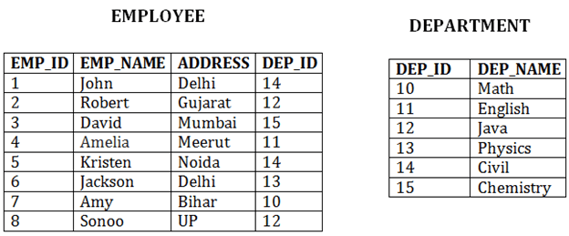
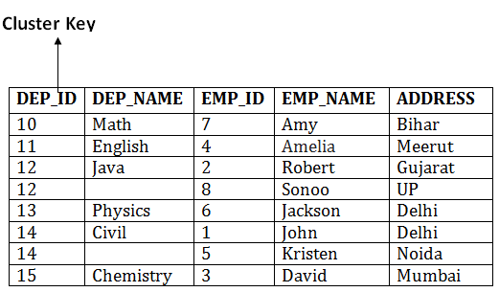
In this method, we can directly insert, update or delete any record. Data is sorted based on the key with which searching is done. Cluster key is a type of key with which joining of the table is performed.

Slide 14
Types of Cluster file organization:
Cluster file organization is of two types:
1. Indexed Clusters:
In indexed cluster, records are grouped based on the cluster key and stored together.
The above EMPLOYEE and DEPARTMENT relationship is an example of an indexed cluster. Here, all the records are grouped based on the cluster key- DEP_ID and all the records are grouped.
2. Hash Clusters:
It is similar to the indexed cluster.
In hash cluster, instead of storing the records based on the cluster key, we generate the value of the hash key for the cluster key and store the records with the same hash key value.

Slide 15
Pros of Cluster file organization
The cluster file organization is used when there is a frequent request for joining the tables with same joining condition.
It provides the efficient result when there is a 1:M mapping between the tables.
Cons of Cluster file organization
This method has the low performance for the very large database.
If there is any change in joining condition, then this method cannot use. If we change the condition of joining then traversing the file takes a lot of time.
This method is not suitable for a table with a 1:1 condition.

Slide 16
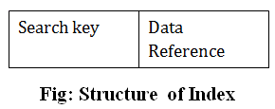
Indexing in DBMS
Indexing is used to optimize the performance of a database by minimizing the number of disk accesses required when a query is processed.
The index is a type of data structure. It is used to locate and access the data in a database table quickly.
Index structure:
Indexes can be created using some database columns.

Slide 17
The first column of the database is the search key that contains a copy of the primary key or candidate key of the table.
The values of the primary key are stored in sorted order so that the corresponding data can be accessed easily.
The second column of the database is the data reference.
It contains a set of pointers holding the address of the disk block where the value of the particular key can be found.

Slide 18
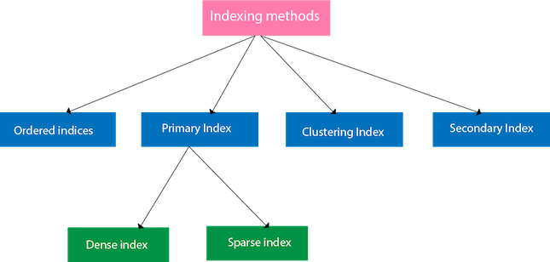
Indexing Methods

Slide 19
Ordered indices
The indices are usually sorted to make searching faster. The indices which are sorted are known as ordered indices.
Example: Suppose we have an employee table with thousands of record and each of which is 10 bytes long. If their IDs start with 1, 2, 3....and so on and we have to search student with ID-543.
In the case of a database with no index, we have to search the disk block from starting till it reaches 543. The DBMS will read the record after reading 543*10=5430 bytes.
In the case of an index, we will search using indexes and the DBMS will read the record after reading 542*2= 1084 bytes which are very less compared to the previous case.

Slide 20
Primary Index
If the index is created on the basis of the primary key of the table, then it is known as primary indexing. These primary keys are unique to each record and contain 1:1 relation between the records.
As primary keys are stored in sorted order, the performance of the searching operation is quite efficient.
The primary index can be classified into two types: Dense index and Sparse index.
Dense index
The dense index contains an index record for every search key value in the data file. It makes searching faster.
In this, the number of records in the index table is same as the number of records in the main table.
It needs more space to store index record itself. The index records have the search key and a pointer to the actual record on the disk.

Slide 21
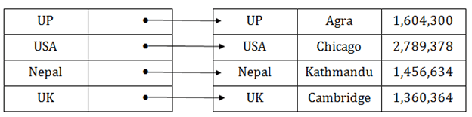
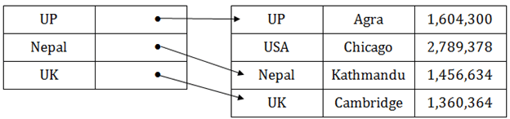
Sparse index
In the data file, index record appears only for a few items. Each item points to a block.
In this, instead of pointing to each record in the main table, the index points to the records in the main table in a gap.

Slide 22
Clustering Index
A clustered index can be defined as an ordered data file. Sometimes the index is created on non-primary key columns which may not be unique for each record.
In this case, to identify the record faster, we will group two or more columns to get the unique value and create index out of them. This method is called a clustering index.
The records which have similar characteristics are grouped, and indexes are created for these group.
Example: suppose a company contains several employees in each department. Suppose we use a clustering index, where all employees which belong to the same Dept_ID are considered within a single cluster, and index pointers point to the cluster as a whole. Here Dept_Id is a non-unique key.

Slide 23
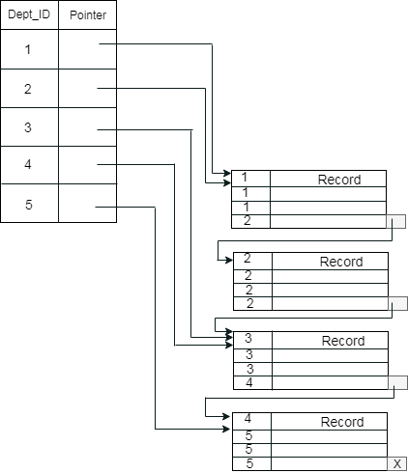

Slide 24
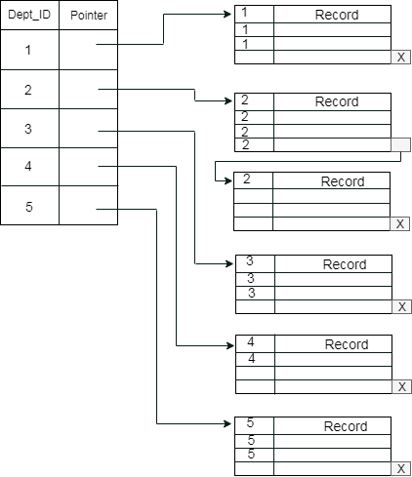
The previous schema is little confusing because one disk block is shared by records which belong to the different cluster. If we use separate disk block for separate clusters, then it is called better technique.

Slide 25
Secondary Index
In the sparse indexing, as the size of the table grows, the size of mapping also grows.
These mappings are usually kept in the primary memory so that address fetch should be faster.
Then the secondary memory searches the actual data based on the address got from mapping.
If the mapping size grows then fetching the address itself becomes slower. In this case, the sparse index will not be efficient.
To overcome this problem, secondary indexing is introduced.
In secondary indexing, to reduce the size of mapping, another level of indexing is introduced.

Slide 26
In this method, the huge range for the columns is selected initially so that the mapping size of the first level becomes small.
Then each range is further divided into smaller ranges. The mapping of the first level is stored in the primary memory, so that address fetch is faster.
The mapping of the second level and actual data are stored in the secondary memory (hard disk).

Slide 27
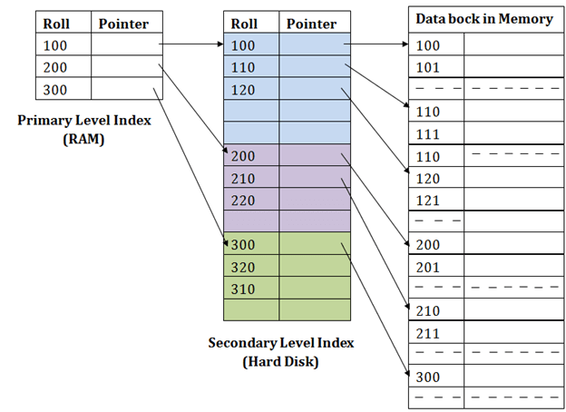

Slide 28
For example:
If you want to find the record of roll 111 in the diagram, then it will search the highest entry which is smaller than or equal to 111 in the first level index. It will get 100 at this level.
Then in the second index level, again it does max (111) <= 111 and gets 110. Now using the address 110, it goes to the data block and starts searching each record till it gets 111.
This is how a search is performed in this method. Inserting, updating or deleting is also done in the same manner.

Slide 29
B+ Tree
The B+ tree is a balanced binary search tree. It follows a multi-level index format.
In the B+ tree, leaf nodes denote actual data pointers. B+ tree ensures that all leaf nodes remain at the same height.
In the B+ tree, the leaf nodes are linked using a link list. Therefore, a B+ tree can support random access as well as sequential access.
Structure of B+ Tree
In the B+ tree, every leaf node is at equal distance from the root node. The B+ tree is of the order n where n is fixed for every B+ tree.
It contains an internal node and leaf node.

Slide 30
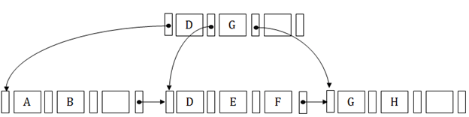
Internal node
An internal node of the B+ tree can contain at least n/2 record pointers except the root node.
At most, an internal node of the tree contains n pointers.
Leaf node
The leaf node of the B+ tree can contain at least n/2 record pointers and n/2 key values.
At most, a leaf node contains n record pointer and n key values.
Every leaf node of the B+ tree contains one block pointer P to point to next leaf node.

Slide 31
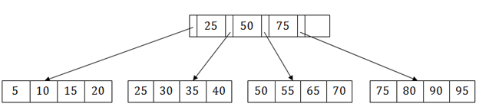
Searching a record in B+ Tree
Suppose we have to search 55 in the below B+ tree structure.
First, we will fetch for the intermediary node which will direct to the leaf node that can contain a record for 55.
So, in the intermediary node, we will find a branch between 50 and 75 nodes.
Then at the end, we will be redirected to the third leaf node. Here DBMS will perform a sequential search to find 55.

Slide 32
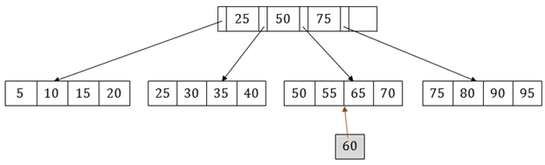
B+ Tree Insertion
Suppose we want to insert a record 60 in the below structure. It will go to the 3rd leaf node after 55. It is a balanced tree, and a leaf node of this tree is already full, so we cannot insert 60 there.
In this case, we have to split the leaf node, so that it can be inserted into tree without affecting the fill factor, balance and order.

Slide 33
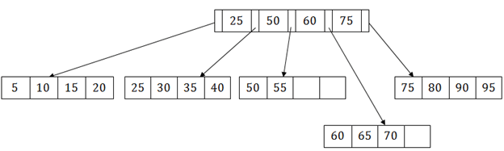
The 3rd leaf node has the values (50, 55, 60, 65, 70) and its current root node is 50. We will split the leaf node of the tree in the middle so that its balance is not altered. So we can group (50, 55) and (60, 65, 70) into 2 leaf nodes.
If these two has to be leaf nodes, the intermediate node cannot branch from 50. It should have 60 added to it, and then we can have pointers to a new leaf node.
This is how we can insert an entry when there is overflow. In a normal scenario, it is very easy to find the node where it fits and then place it in that leaf node.

Slide 34
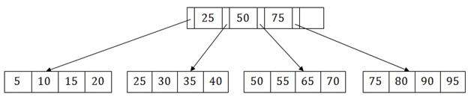
B+ Tree Deletion
Suppose we want to delete 60 from the above example. In this case, we have to remove 60 from the intermediate node as well as from the 4th leaf node too. If we remove it from the intermediate node, then the tree will not satisfy the rule of the B+ tree. So we need to modify it to have a balanced tree.
After deleting node 60 from above B+ tree and re-arranging the nodes, it will show as follows:

Slide 35
Hashing is an efficient technique to directly search the location of desired data on the disk without using index structure. Data is stored at the data blocks whose address is generated by using hash function. The memory location where these records are stored is called as data block or data bucket.

Slide 36
Hash File Organization:
Data bucket – Data buckets are the memory locations where the records are stored. These buckets are also considered as Unit Of Storage.
Hash Function – Hash function is a mapping function that maps all the set of search keys to actual record address. Generally, hash function uses the primary key to generate the hash index – address of the data block. Hash function can be simple mathematical function to any complex mathematical function.
Hash Index-The prefix of an entire hash value is taken as a hash index. Every hash index has a depth value to signify how many bits are used for computing a hash function. These bits can address 2n buckets. When all these bits are consumed ? then the depth value is increased linearly and twice the buckets are allocated.

Slide 37
Static Hashing:
In static hashing, when a search-key value is provided, the hash function always computes the same address.
For example, if we want to generate an address for STUDENT_ID = 104 using mod (5) hash function, it always results in the same bucket address 4.
There will not be any changes to the bucket address here. Hence a number of data buckets in the memory for this static hashing remain constant throughout.

Slide 38
Operations:
Insertion – When a new record is inserted into the table, The hash function h generates a bucket address for the new record based on its hash key K. Bucket address = h(K)
Searching – When a record needs to be searched, The same hash function is used to retrieve the bucket address for the record. For Example, if we want to retrieve the whole record for ID 104, and if the hash function is mod (5) on that ID, the bucket address generated would be 4. Then we will directly got to address 4 and retrieve the whole record for ID 104. Here ID acts as a hash key.
Deletion – If we want to delete a record, Using the hash function we will first fetch the record which is supposed to be deleted. Then we will remove the records for that address in memory.
Updation – The data record that needs to be updated is first searched using hash function, and then the data record is updated.

Slide 39
Now, If we want to insert some new records into the file But the data bucket address generated by the hash function is not empty or the data already exists in that address.
This becomes a critical situation to handle. This situation in the static hashing is called bucket overflow.
How will we insert data in this case? There are several methods provided to overcome this situation. Some commonly used methods are discussed below:
Open Hashing –
In Open hashing method, next available data block is used to enter the new record, instead of overwriting the older one. This method is also called linear probing.
For example, D3 is a new record that needs to be inserted, the hash function generates the address as 105.
But it is already full. So the system searches next available data bucket, 123 and assigns D3 to it.

Slide 40
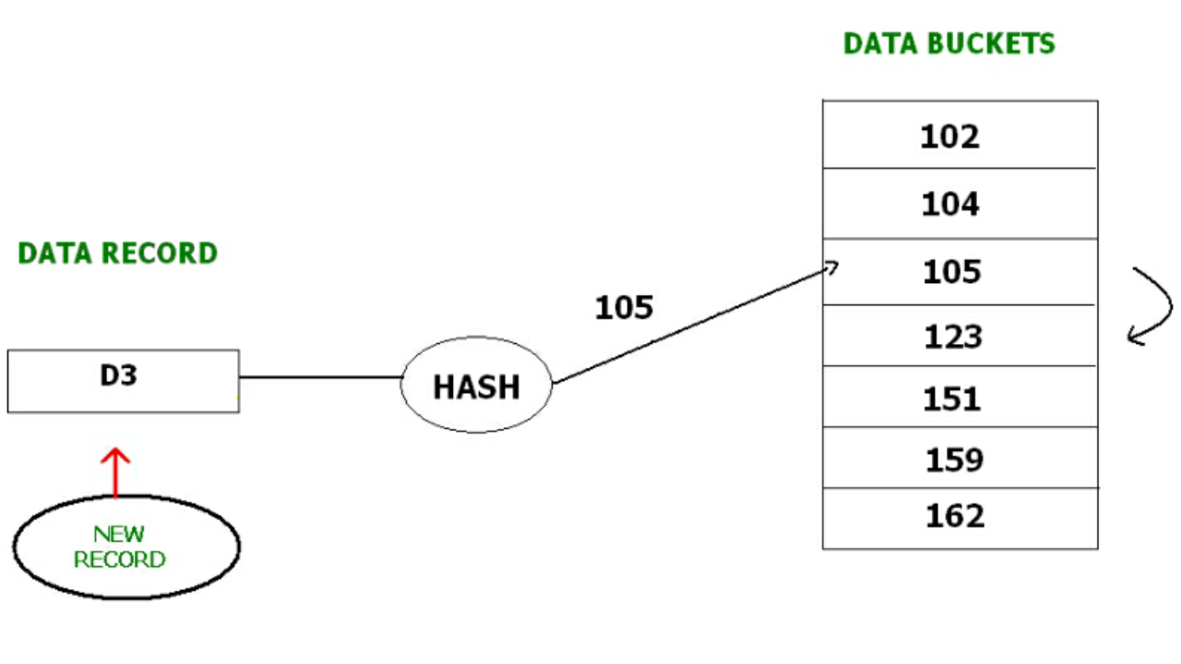

Slide 41
Closed hashing –
In Closed hashing method, a new data bucket is allocated with same address and is linked it after the full data bucket.
This method is also known as overflow chaining. For example, we have to insert a new record D3 into the tables.
The static hash function generates the data bucket address as 105. But this bucket is full to store the new data.
In this case is a new data bucket is added at the end of 105 data bucket and is linked to it. Then new record D3 is inserted into the new bucket.

Slide 42
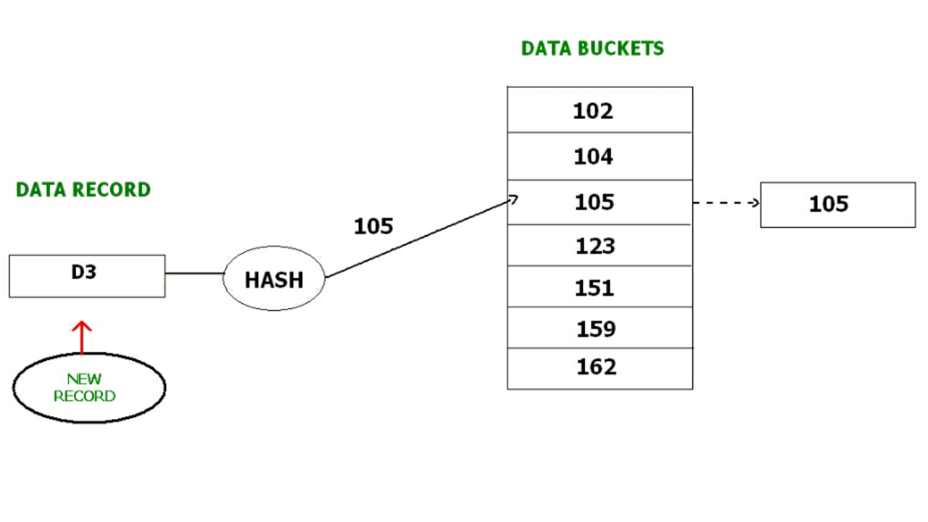

Slide 43
Quadratic probing : Quadratic probing is very much similar to open hashing or linear probing. Here, The only difference between old and new bucket is linear. Quadratic function is used to determine the new bucket address.
Double Hashing : Double Hashing is another method similar to linear probing. Here the difference is fixed as in linear probing, but this fixed difference is calculated by using another hash function. That’s why the name is double hashing.

Slide 44
Dynamic Hashing –
The drawback of static hashing is that it does not expand or shrink dynamically as the size of the database grows or shrinks.
In Dynamic hashing, data buckets grows or shrinks (added or removed dynamically) as the records increases or decreases. Dynamic hashing is also known as extended hashing.
In dynamic hashing, the hash function is made to produce a large number of values.
For Example, there are three data records D1, D2 and D3 . The hash function generates three addresses 1001, 0101 and 1010 respectively.
This method of storing considers only part of this address – especially only first one bit to store the data. So it tries to load three of them at address 0 and 1.

Slide 45
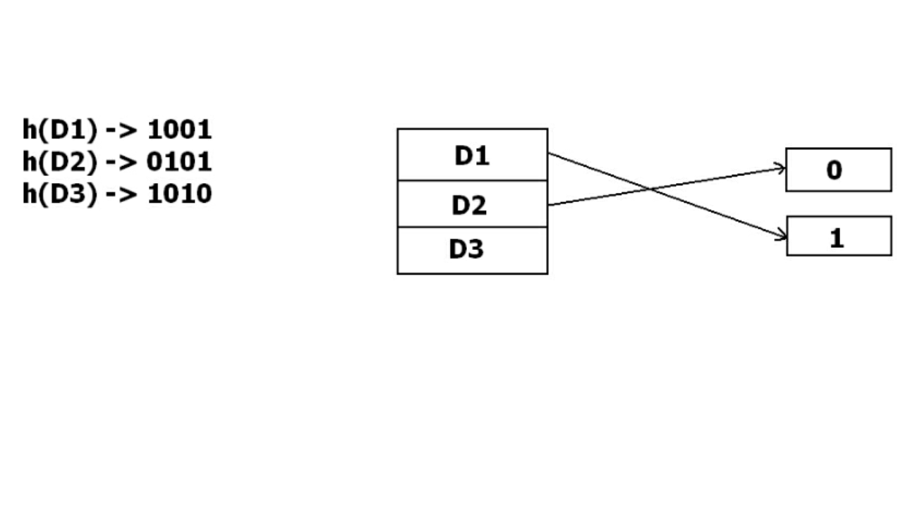
But the problem is that No bucket address is remaining for D3. The bucket has to grow dynamically to accommodate D3. So it changes the address have 2 bits rather than 1 bit, and then it updates the existing data to have 2 bit address. Then it tries to accommodate D3.

Slide 46
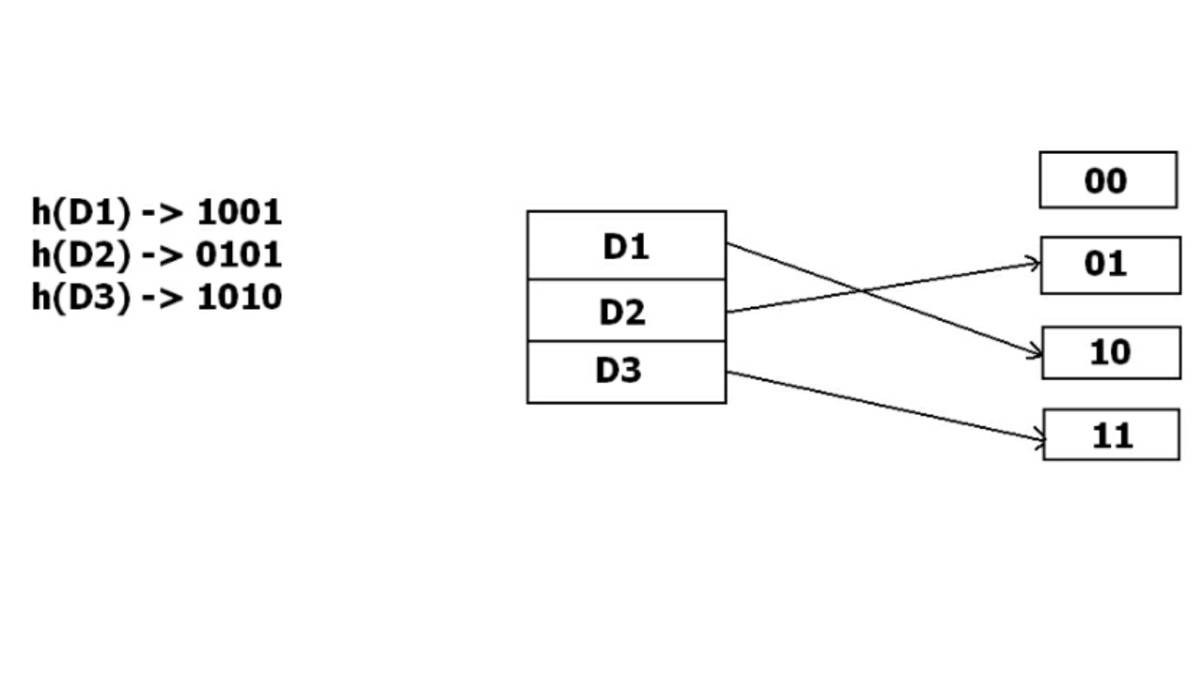

Slide 47
B-tree index files
B tree index file is similar to B+ tree index files, but it uses binary search concepts.
In this method, each root will branch to only two nodes and each intermediary node will also have the data. And leaf node will have lowest level of data.
However, in this method also, records will be sorted. Since all intermediary nodes also have records, it reduces the traversing till leaf node for the data.
A simple B tree can be represented as below:

Slide 48
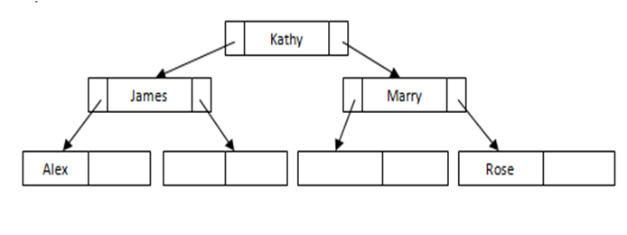
There is no repetition or pointers till leaf node. All the records are stored in all the nodes.
If we need to insert any record, it will be done as B+ tree index files, but it will make sure that each node will branch only to two nodes.
If there is not enough space in any of the node, it will split the node and store the records.

Slide 49
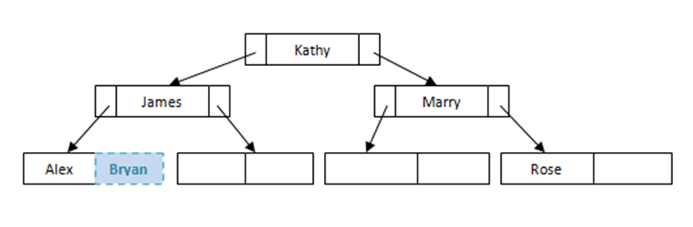
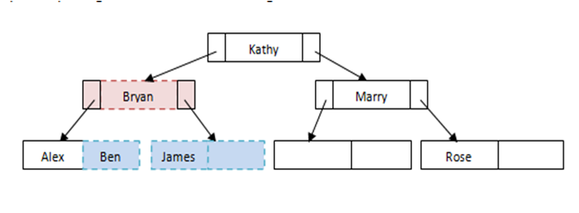
Example of Simple Insert
Example of splitting the nodes while inserting

Slide 50
Query Processing

Slide 51
Query Processing is the activity performed in extracting data from the database.
In query processing, it takes various steps for fetching the data from the database. The steps involved are:
Parsing and translation
Optimization
Evaluation
The query processing works in the following way:

Slide 52
Parsing and Translation
As query processing includes certain activities for data retrieval. Initially, the given user queries get translated in high-level database languages such as SQL.
It gets translated into expressions that can be further used at the physical level of the file system.
After this, the actual evaluation of the queries and a variety of query -optimizing transformations and takes place.
Thus before processing a query, a computer system needs to translate the query into a human-readable and understandable language.
Consequently, SQL or Structured Query Language is the best suitable choice for humans.
But, it is not perfectly suitable for the internal representation of the query to the system.

Slide 53
Relational algebra is well suited for the internal representation of a query. The translation process in query processing is similar to the parser of a query.
When a user executes any query, for generating the internal form of the query, the parser in the system checks the syntax of the query, verifies the name of the relation in the database, the tuple, and finally the required attribute value.
The parser creates a tree of the query, known as 'parse-tree.' Further, translate it into the form of relational algebra. With this, it evenly replaces all the use of the views when used in the query.
Thus, we can understand the working of a query processing in the below-described diagram:

Slide 54
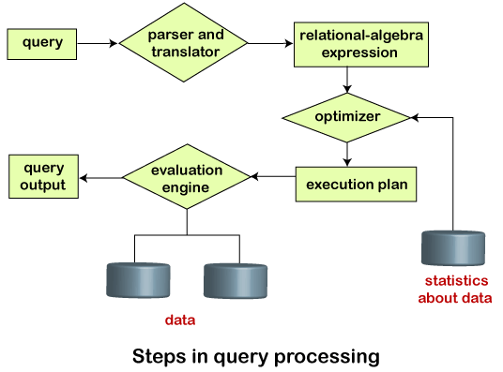

Slide 55
Suppose a user executes a query. As we have learned that there are various methods of extracting the data from the database. In SQL, a user wants to fetch the records of the employees whose salary is greater than or equal to 10000. For doing this, the following query is undertaken:
select emp_name from Employee where salary>10000;
Thus, to make the system understand the user query, it needs to be translated in the form of relational algebra. We can bring this query in the relational algebra form as:
σ_{salary>10000} (π_{salary} (Employee))
π_{salary} (σ_{salary>10000} (Employee))
After translating the given query, we can execute each relational algebra operation by using different algorithms. So, in this way, a query processing begins its working.

Slide 56
Evaluation
For this, with addition to the relational algebra translation, it is required to annotate the translated relational algebra expression with the instructions used for specifying and evaluating each operation. Thus, after translating the user query, the system executes a query evaluation plan.
Query Evaluation Plan
In order to fully evaluate a query, the system needs to construct a query evaluation plan.
The annotations in the evaluation plan may refer to the algorithms to be used for the particular index or the specific operations.
Such relational algebra with annotations is referred to as Evaluation Primitives. The evaluation primitives carry the instructions needed for the evaluation of the operation.
Thus, a query evaluation plan defines a sequence of primitive operations used for evaluating a query. The query evaluation plan is also referred to as the query execution plan.
A query execution engine is responsible for generating the output of the given query. It takes the query execution plan, executes it, and finally makes the output for the user query.

Slide 57
Optimization
The cost of the query evaluation can vary for different types of queries. Although the system is responsible for constructing the evaluation plan, the user does need not to write their query efficiently.
Usually, a database system generates an efficient query evaluation plan, which minimizes its cost. This type of task performed by the database system and is known as Query Optimization.
For optimizing a query, the query optimizer should have an estimated cost analysis of each operation. It is because the overall operation cost depends on the memory allocations to several operations, execution costs, and so on.

